Slide 1
Naive Bayes Classifier

Slide 2
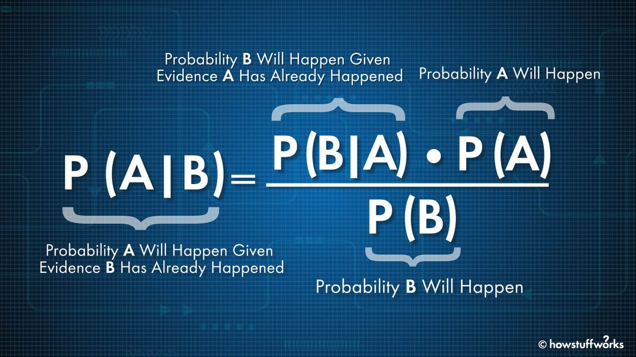
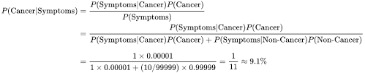
Formula for Naive Bayes Classifier

Slide 3
Gaussian Naive Bayes
Types of Naive Bayes
Bernoulli Naive Bayes
Multinomial Naive Bayes

Slide 4
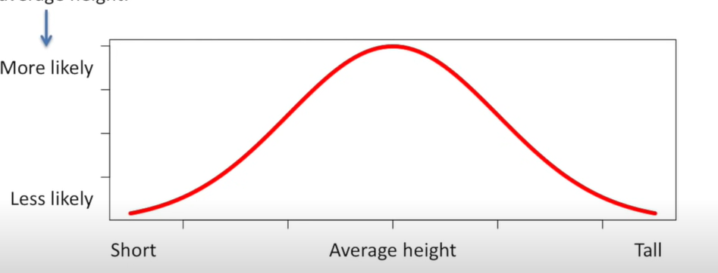
Gaussian Naive Bayes
This type of Naive Bayes is used when variables are continuous in nature. It assumes that all the variables have a normal distribution..

Slide 5
Multinomial Naive Bayes
This is used when the features represent the frequency.
Suppose you have a text document and you extract all the unique words and create multiple features where each feature represents the count of the word in the document. In such a case, we have a frequency as a feature. In such a scenario, we use multinomial Naive Bayes.

Slide 6
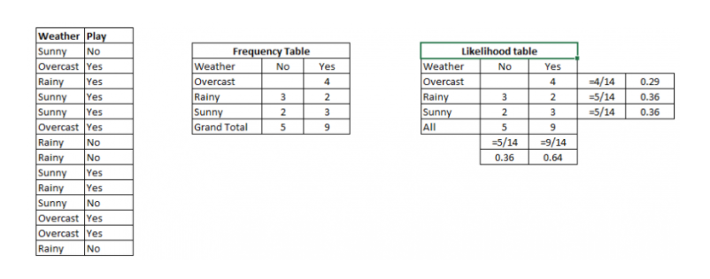
Applying Bayes'theorem:
P(Yes|Sunny)= P(Sunny|Yes)*P(Yes)/P(Sunny)
P(Sunny|Yes)= 3/10= 0.3
P(Sunny)= 0.35
P(Yes)=0.71
volume is gedempt
So P(Yes|Sunny) = 0.3*0.71/0.35= 0.60
P(No|Sunny)= P(Sunny|No)*P(No)/P(Sunny)
P(Sunny|NO)= 2/4=0.5
P(No)= 0.29
P(Sunny)= 0.35
So P(No|Sunny)= 0.5*0.29/0.35 = 0.41
So as we can see from the above calculation that P(Yes|Sunny)>P(No|Sunny)

Slide 7
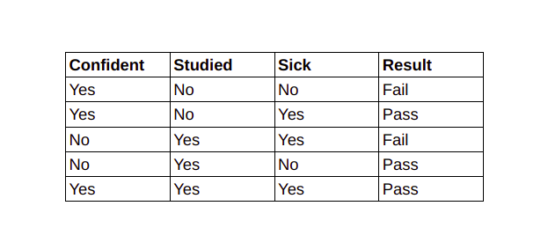
Bernoulli Naive Bayes
This is used when features are binary. So, instead of using the frequency of the word, if you have discrete features in 1s and 0s that represent the presence or absence of a feature. In that case, the features will be binary and we will use Bernoulli Naive Bayes.

Slide 8
Let’s Understand Naive Bayes with an Example

Slide 9
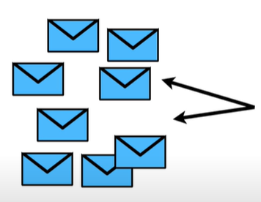
The normal and important messages we receive

Slide 10
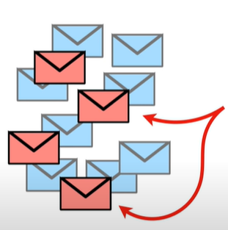
Spam messages which we receive(unwanted messages that are spams or unsolicited advertisements.

Slide 11
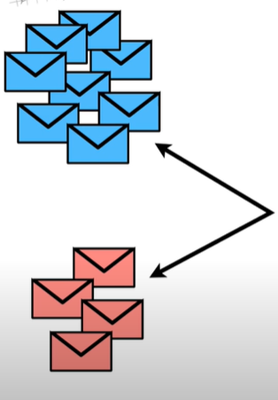
So now what can we do if we want to filter these normal and spam messages??

Slide 12
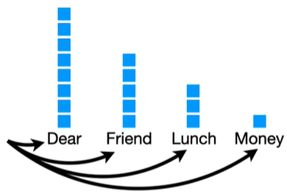

Firstly we have to make a histogram of all the words that occur frequently in Normal messages.
And this histogram can be used to calculate the probabilities of the occurrence of words in the normal message.

Slide 13

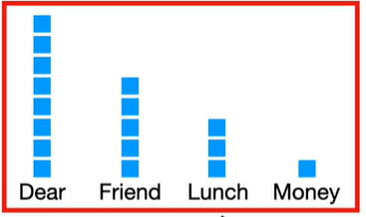

The total number of times ‘Dear’ occurred in the normal message is 8.
And the total number of words occurred in normal messages is 17.
The probability of occurrence of dear in the normal message is 0.47.

Slide 14







Slide 15
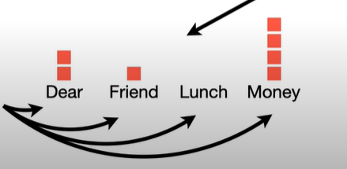

Now we have to make a histogram of all the words that occur frequently in Spam messages.

Slide 16


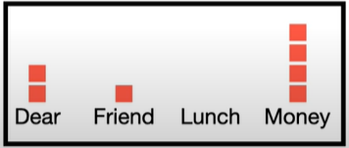







Slide 17
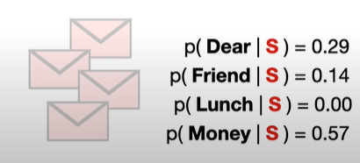
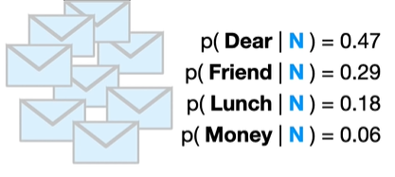
Here we have calculated the probabilities of discrete,individual words and not the probability of something continuous like weight,height.These type of probabilities are called as likelihoods.

Slide 18
Dear Friend
Now we need to identify whether it is a Normal Message or Spam

Slide 19
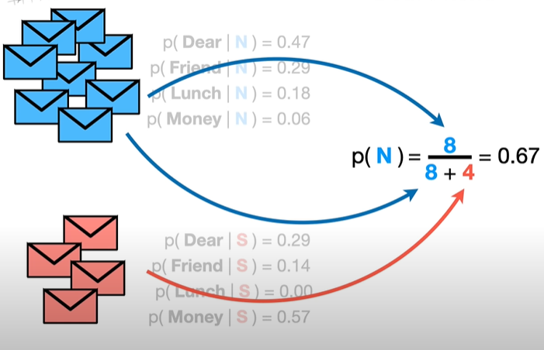
Since 8 of the 12 messages are normal messages here,probability of normal messages is 0.67
The initial guess we observe here as a Normal message is called a Prior Probability.

Slide 20



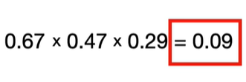

Probability of Dear Friend being a normal message.
Multiply the initial guess by the probability that the word dear occurs in the normal message and probability that the word Friend occurs in the normal message
We can consider 0.09 as the score Dear Friend gets if it is the normal message

Slide 21
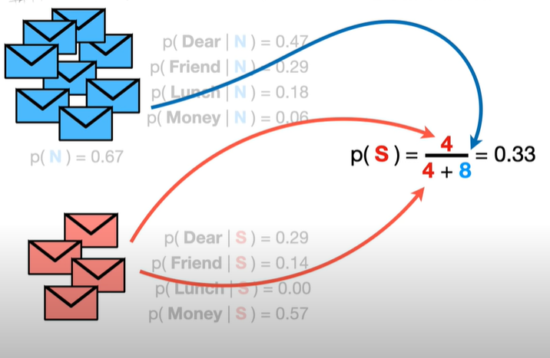
Probability of a message being spam
Just like before we did before,we start with an initial guess about the probability that any message regardless of what it says ,is spam.

Slide 22



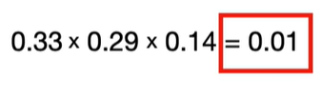
Probability of “Dear Friend” being a spam message.
Multiply the initial guess by the probability that the word dear occurs in the spam message and probability that the word Friend occurs in the spam message
We can consider 0.01 as the score Dear Friend gets if it is spam.

Slide 23

Probability of Dear Friend being a normal message.
0.09
Probability of “Dear Friend” being a spam message.
0.01
Probability of “Dear Friend” being a spam message.
Probability of Dear Friend being a normal message.
Hence,”Dear Friend” is a normal message and not a spam message.

Slide 25




Slide 26
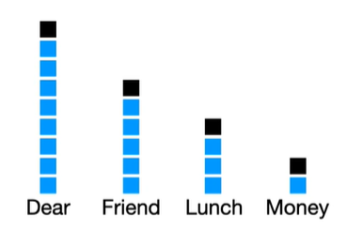
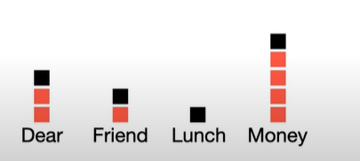
The number of counts we add to each word is referred with the greek letter alpha.
In this case, alpha=1 ,but we can consider any value for alpha.

Slide 27
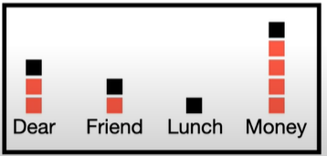

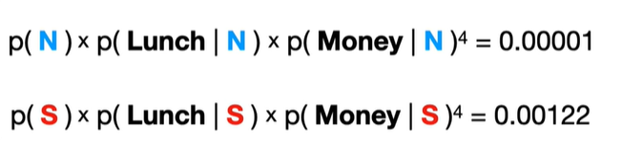

Spam!!!!!!!!!!!

Slide 28
Applications of Naive Bayes
Face Recognition :As a classifier, it is used to identify the faces or its other features, like nose, mouth, eyes, etc.
Weather Prediction:It can be used to predict if the weather will be good or bad.
Medical Diagnosis: Doctors can diagnose patients by using the information that the classifier provides. Healthcare professionals can use Naive Bayes to indicate if a patient is at high risk for certain diseases and conditions, such as heart disease, cancer, and other ailments.
News Classification: With the help of a Naive Bayes classifier, Google News recognizes whether the news is political, world news, and so on. As the Naive Bayes Classifier has so many applications, it’s worth learning more about how it works.

Slide 29
Text Classification
Most of the time, Naive Bayes finds uses in-text classification due to its assumption of independence and high performance in solving multi-class problems. It enjoys a high rate of success than other algorithms due to its speed and efficiency.
Sentiment Analysis
One of the most prominent areas of machine learning is sentiment analysis, and this algorithm is quite useful there as well. Sentiment analysis focuses on identifying whether the customers think positively or negatively about a certain topic (product or service).
Recommender Systems
With the help of Collaborative Filtering, Naive Bayes Classifier builds a powerful recommender system to predict if a user would like a particular product (or resource) or not. Amazon, Netflix, and Flipkart are prominent companies that use recommender systems to suggest products to their customers.

Slide 30
Advantages of Naive Bayes
It is simple and easy to implement
It doesn’t require as much training data
It handles both continuous and discrete data
It is highly scalable with the number of predictors and data points
It is fast and can be used to make real-time predictions
It is not sensitive to irrelevant features
Naive Bayes is suitable for solving multi-class prediction problems.
Naive Bayes best suits the categorical input variables than the numerical values.

Slide 31
Disadvantages of Naive Bayes
Naive Bayes assumes that all predictors (or features) are independent, rarely happening in real life. This limits the applicability of this algorithm in real-world use cases.
This algorithm faces the ‘zero-frequency problem’ where it assigns zero probability to a categorical variable whose category in the test data set wasn’t available in the training dataset. It would be best if you used a smoothing technique to overcome this issue.
Its estimations can be wrong in some cases, so you shouldn’t take its probability outputs very seriously.

